Slide 1

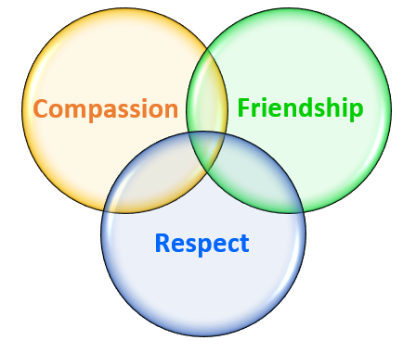
Welcome Year 3 & 4 Parents
AT

Slide 2
Year 3 & 4 Meet the team…
Mr Taylor & Mrs Martin - Zephaniah Class
Mr Elkins - Riddell Class
Miss Taylor - Rauf Class
Mrs Parlane & Mrs Harvey - Morpurgo Class
Miss Jupp - Cowell Class
We are also supported by a number of LSPs with a wide range of skills
AT

Slide 3
School Day in Year 3 & 4
8.30-8.50am Registration & Early morning activities
8.50-9.05am Worship (Class/Whole School/Phase)
9.10am-9.40am Spelling / Phonics
9.40-10.35am Maths/Writing
10.35-10.50 KS2 Break
10.50-11.45 am Writing/Maths
11.45-12.15pm Talk for Reading
12.15-1.15pm Lunch
1.15- 3.10pm- Foundation Subjects (Topic/Science/PE/RE/Music) & other Activities Maths retrieval, Reading for pleasure, Library, Mile Run etc
LT

Slide 4
Morning Routines
Children need to be on time and ready to learn – morning tasks ‘warm them up’ ready for the day.
Doors open 8:30 – 8:40 → go through the office if they are late
Register is taken at 8:40
Attendance – we aim for 96%.
Anything below 90% is classified as persistently absent.
Lunches are displayed in the classroom- there is a three week timetable.
Children can order in the morning or pre-order through Scopay.
All children must bring in a named water bottle – Please let us know if they don’t have one so we can provide a cup for the day.
VP

Slide 5
Presentation
Each day, we expect the children to come into school wearing the Bramley School Uniform.
School jumpers/cardigans/fleeces and coats
must be named.
Long hair (boys and girls) should be tied back at all times – avoid distractions from work and for hygiene.
Earrings – should be small studs and easily removable for PE by the children.
School Uniform
Trousers, Skirt - Navy, black or grey; blue or Pinafore Dress and white gingham check dress in summer
Shirt or Polo Shirt - White
Jumper/Cardigan - School sweatshirt/cardigan
Footwear - Plain, sensible, black, low heeled shoes or plain black trainers (without any markings)
This has not changed since last year – we have several children with trainers that are not plain black.
Many children without school jumpers.
School Uniform Swap Shop – have lots of jumpers and cardigans
EJ

Slide 6
PE Days
Children wear their PE kits into school on their set days.
Light blue T Shirt or polo
Black or navy shorts (plain jogging bottoms in colder weather)
Trainers
Change of socks
Bramley hoodie/fleece or school jumper
Earrings removed or taped over
Hair tied back
Classes also do mile runs (Y3 Friday, Y4 Wednesday) Children can run in trainers or walk quickly in school shoes.
Children can bring in trainers in their school bags to change into for their Mile Run if they wear school shoes.
LE

Slide 7
Swimming
Cowell & Morpurgo
Tuesday 16th September
Tuesday 23rd September
Tuesday 30th September
Tuesday 7th October
Tuesday 14th October
Tuesday 21st October
Rauf
Thursday 18th September
Thursday 25th September
Thursday 2nd October
Thursday 9th October
Thursday 16th October
Thursday 23rd October
LT

Slide 8
Our Year 3 Topics
Related Trips and Visitors
This year, we hope to ….
Anglo Saxon Adventure – Spring 1
VR Ancient Egyptian Experience – Spring 2
Winchester Science Centre – Summer 2
Victorian Life
We Will Rock You!
Saxon Invasion!
Ancient Egyptians
Lights, Camera, Action
Ready, Steady, Cook
Outcome Events
Victorian Day – 22/10/25
Egyptian Museum – End of Spring 2
Shadow Puppet Theatre – End of Summer 1
AT

Slide 9
Our Year 4 Topics
Related Trips and Visitors
This year, we hope to ….
Swimming – Autumn 1
Animals into school – Summer 1
Ufton Court – Summer 2 -Residential in June (Details to follow)
Ready, Steady Go (Sporting events)
Romans
Volcanoes and Earthquakes
The Ancient Maya
The Tree of Life (Animals and classification)
Vikings
Outcome Events
We hope to have a range of opportunities this year where we can invite you into school to share the children’s learning and achievements. Our first will be on Monday 13th October.
We will send further details closer to the time.
EJ

Slide 10

Termly Topic Overview
This can be found on the School Website In the Year group pages
LE

Slide 11
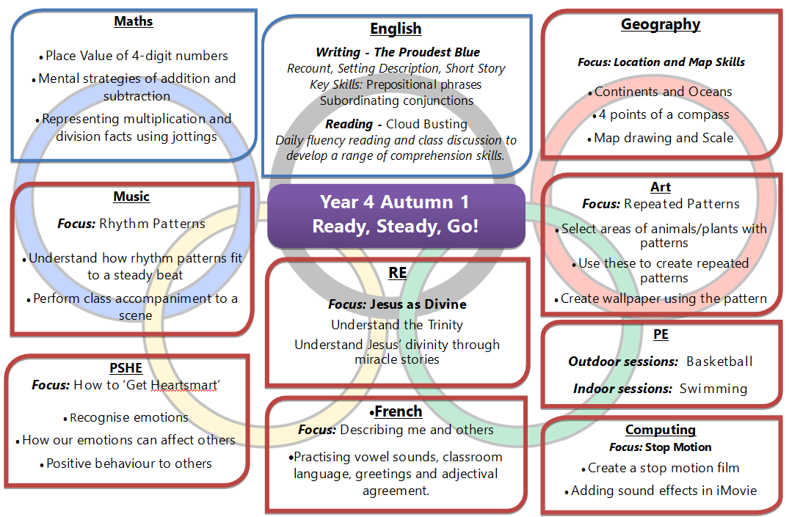
Termly Topic Overview
This can be found on the School Website In the Year group pages
VP

Slide 12
Behaviour Expectations
Children are expected to:
actively participate in lessons.
- listen and join in discussions
take responsibility for their own learning.
- work hard and try to achieve their best
move between spaces in class and work collaboratively with a range of children
show the same level of respect to every staff member, including lunch staff.
AT
Notes:
FM

Slide 13
Rewards and Sanctions
We use a range of methods to reward behaviour, attitude, effort and achievements in school.
Verbal praise Comments in books House Points
Bronze, Silver and Gold Stickers
Sharing with another adult, Miss Denham, Mrs Hanson, or Mr Moore
Celebration Assemblies
Children are given lots of support within lessons to complete their learning and achieve their best. If this isn’t done, on occasion they may need to complete their work at break or lunchtime.
If children’s behaviour or attitudes fall below our expectations, they may need to work with a member of the Senior Leadership Team to discuss their behaviour, with the aim to help them to put it right and change their behaviour for the future.
We will also contact parents to discuss events to work together with the child.
LE
Notes:
FM

Slide 14
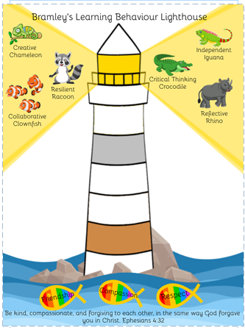
Rewards and Sanctions
LT
Notes:
FM

Slide 15
Learning at Home
As a school, we set tasks to continue children’s learning at home.
Tasks will always be set on a Friday (stuck into their book), to be completed and brought into school the following Wednesday.
Spelling: set words to practise and learn
Maths: times tables practice on TTRS – 3 x 10mins
Homework should not be a battle or take an unreasonable amount of time – if your child is struggling or has taken a long time over a task, please write a brief note in the homework book to let the class teacher know.
If your child has a specific learning need that affects them completing homework, please speak to your child’s class teacher.
EJ

Slide 16
Reading Diaries
Reading is a key skill which affects children in all aspects of their learning and lives.
We ask that children read for at least 10 minutes, 5 times a week.
This should be recorded in reading Diaries and signed by home adults to confirm it has taken place.
Diaries are checked in school every Thursday.
Our Reading Race rewards children and classes who strive to improve their skills through regular reading.
LE

Slide 17

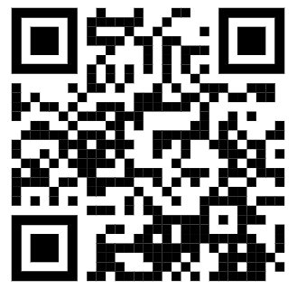
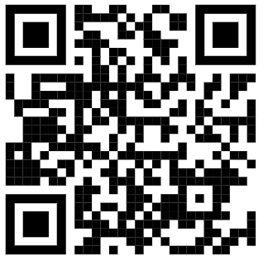

Reading
Year 4
Year 3
VP

Slide 18
Multiplication Tables Check
The MTC takes place during a 2-3week period in June. Your child has 6 seconds to read and input the answer on an iPad. This means verbally they need to answer in 3 seconds.
MTC practice
Home can really help with times tables practice. 10s, 2s and 5s should be secure in Year 2 and 3s, 4s 6s, and 8s should be secure in Year 3.
Autumn 1 – Testing previous times tables for us to get a baseline of where we are.
Revising 10s, 5s and 2s. We will test regularly and the test will be sent home so you can see how much support your child needs.
Autumn 2 – We will revise the 3s, 4s, 6s and 8s. This term we will have a new times table every 2 weeks. Tests will continue to be sent home and previous times tables will be revised.
Spring 1 & 2 – We will work on our Year 4 times tables (7s, 9s, 11s and 12s) and begin to use sound check so the children get used to inputting their answers on the iPad.
EJ

Slide 19
Supporting them at home with times tables
Little and often questioning at home
TTRockstars – logins in homework books
Hit the button
Math-aids.com – Printable worksheets – also good for other areas
Flash Tables
LT

Slide 20
Any Questions?
If you have any questions or concerns, please contact the office and we will get back to you as soon as we can.
Brief messages on the door are fine but if longer conversations are needed please avoid catching us on the door – we need to be concentrating on the children and settling them for the day.
AT

