Slide 1

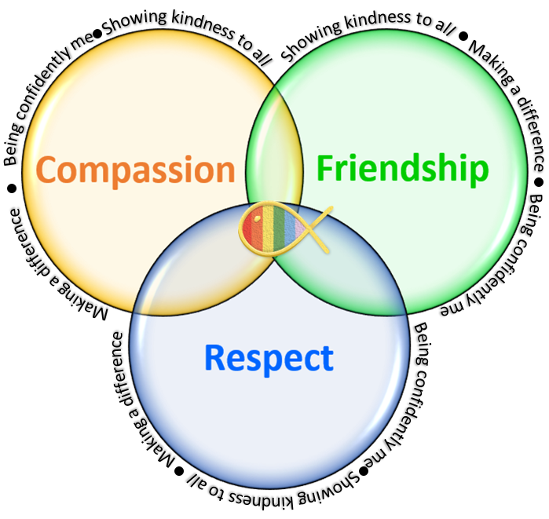
Reading Outcome Event
Welcome to our…

Slide 2
How do you feel about reading?

Slide 3
What is reading like in your house?

Slide 4
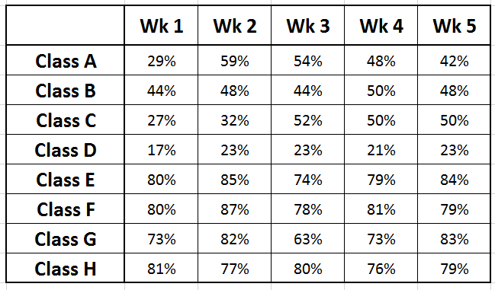
Reading Race
Encouraging children to read 5 times a week at home.
Winning classes – announced with lots of excitement in a Friday assembly & earn a mufti day.
*Trying to encourage children to go home and want to read / earn the reward
EYFS Spring Term

Slide 5
Reading at School
1:1 with an adult
Class books / Story time
Library time
Small group reading
Personal reading time
Comprehension discussions
Phonics and decoding

Slide 6
Reading at School
1:1 with an adult
Class books / Story time
Library time
Small group reading
Personal reading time
Comprehension discussions
Phonics and decoding

Slide 7
Reading is more important than just ‘learning to read’

Slide 8
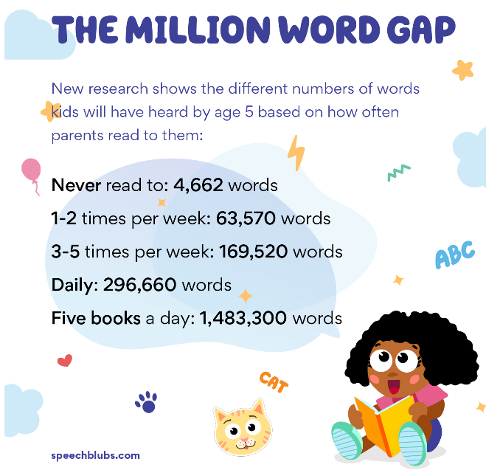
Why reading matters
Reading enjoyment has been reported as more important for children’s educational success than their family’s socio-economic status.
OECD, 2002
Study after study has shown that those children who read for pleasure are the ones who are most likely to fulfil their ambitions.
Pearsons UK research
Reading for pleasure is the single most important indicator of a child’s future success.
Book Trust, 2024
Every lesson and subject in school is so much easier when we can read.

Slide 9
How does reading help children?
Their vocabulary is larger and more extensive.
They perform better academically.
Their imagination can run wild.
Their creativity skills develop.
They develop empathy.
They gain a deeper understanding of their world.
Their concentration levels improve.
The parent and child bond improves.
Their cognitive development is supported.
Their social skills and interaction improve.
National Book Trust research conclusions

Slide 10
How does reading help children?
Their vocabulary is larger and more extensive.
They perform better academically.
Their imagination can run wild.
Their creativity skills develop.
They develop empathy.
They gain a deeper understanding of their world.
Their concentration levels improve.
The parent and child bond improves.
Their thinking skills are developed.
Their social skills and interaction improve.
National Book Trust research conclusions

Slide 11
Reading at School
What we do in school won’t be enough to make them ARE / secure readers.
1:1 with an adult
Class books / Story time
Library time
Small group reading
Personal reading time
Comprehension discussions
Phonics and decoding
What we do in school won’t be enough to make them good thinkers.

Slide 12
We need to take the ‘emotion’ out of reading

Slide 13
Study after study has shown that those children who read for pleasure are the ones who are most likely to fulfil their ambitions.
Pearsons UK research
We need to take the ‘emotion’ out of reading
Regular reading is the single most important indicator of a child’s future success.
Book Trust, 2024

Slide 14
Getting children to read at home can be hard … but we CAN’T give up
…it’s too important.
EYFS / Y1
Don’t leave it until bed time – everyone’s too tired
Practise the tricky word cards and sounds in homework sheets
Keep going until they are automatic
Straight after dinner / first thing in the morning
Visit the library – get excited about books
A mix of school books (Little Wandle) and free choice
Family reading / time
Shared reading – taking it in turns
SORA – if they are struggling to read independently
Celebrate finishing books / calm reading time

Slide 15
Top tips – reading development
Y1
*Use their phonics / knowledge - Sounding out (avoid just telling them)
*Rereading sentences – fluency
*Use the punctuation – full sentences
*Adult reads – child repeats > Good Model
*Reread pages and books several times - automaticity
*Can they self-correct? Do they keep going? They need to spot when they have made a mistake and reread for clarity.

Slide 16
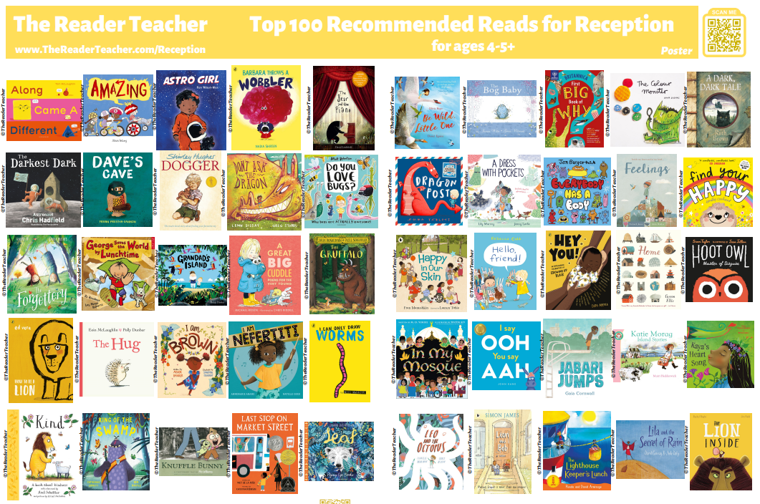

What should we be reading?

Slide 17
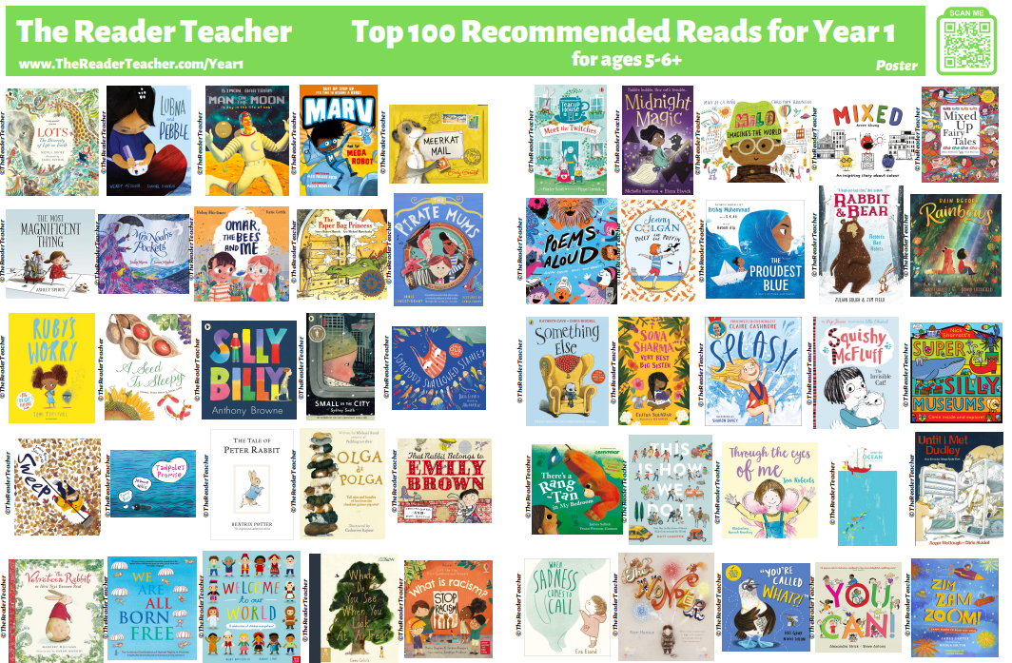

What should we be reading?

Slide 18
Reading Outcome Event
We really hope this helps to get regular, happy reading at home.

